Slide 1
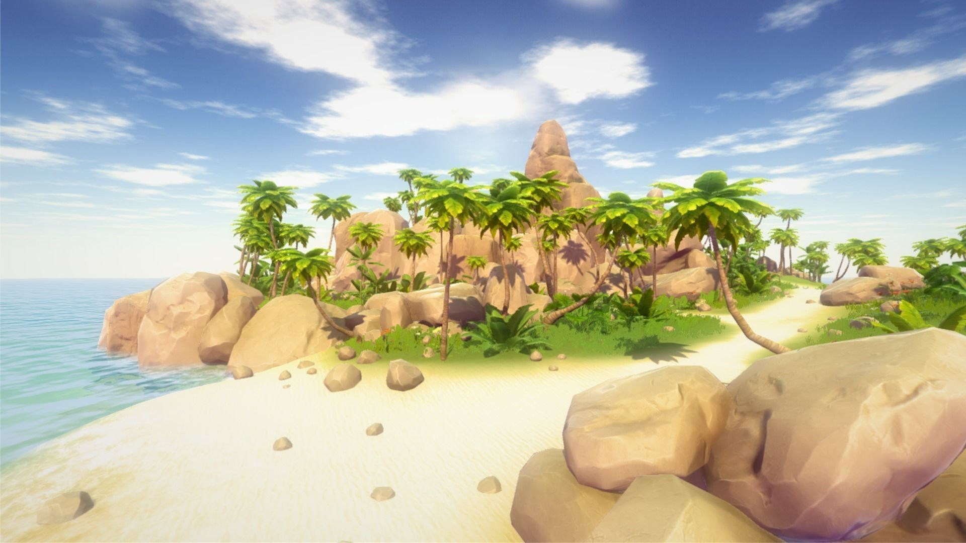
Island Song
Senior Capstone Proposal: Game Dev.
Faculty Advisor: Prof. Thomas Bolinger
Sponsor: Aga Pito Studios
Notes:
? Seconds; Goal: 10 seconds Title Slide: Hello everyone! The team and I have prepared a proposal for the senior capstone game development project.
We have an exciting game concept to share with you today, a game which we have decided to call "Island Song".

Slide 2
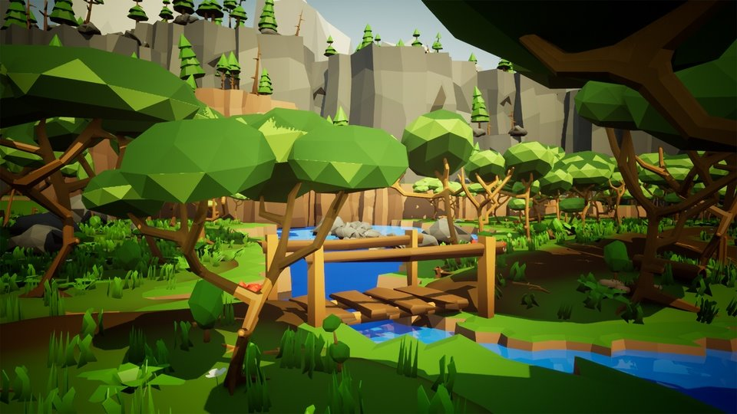
Team Members and Roles
Team Member | Overseeing | Team Role
Steven LaGoy | Game World & Music | Team Lead
Zach McGill | Code Architecture | Project Manager
Logan Faulstich | User Interface
Harrison Niswander | Art and Sound | Treasurer
Ricardo Saldana | Story
Riley Tate | Puzzles | Record-Keeper
SL
Notes:
? Seconds; Goal: 49 seconds
Give team roles, allow members of the team to say their name and role
First, I want to introduce you to our amazing team. We are lucky to be sponsored by Aga Pito Studios. We have an amazing faculty advisor in Professor Thomas Bolinger.
My name is Steven LaGoy, and I am the team lead for this great group of people. I am also overseeing the design of our game world.
Zach
Logan
Ricardo
Riley
Thanks team!

Slide 3
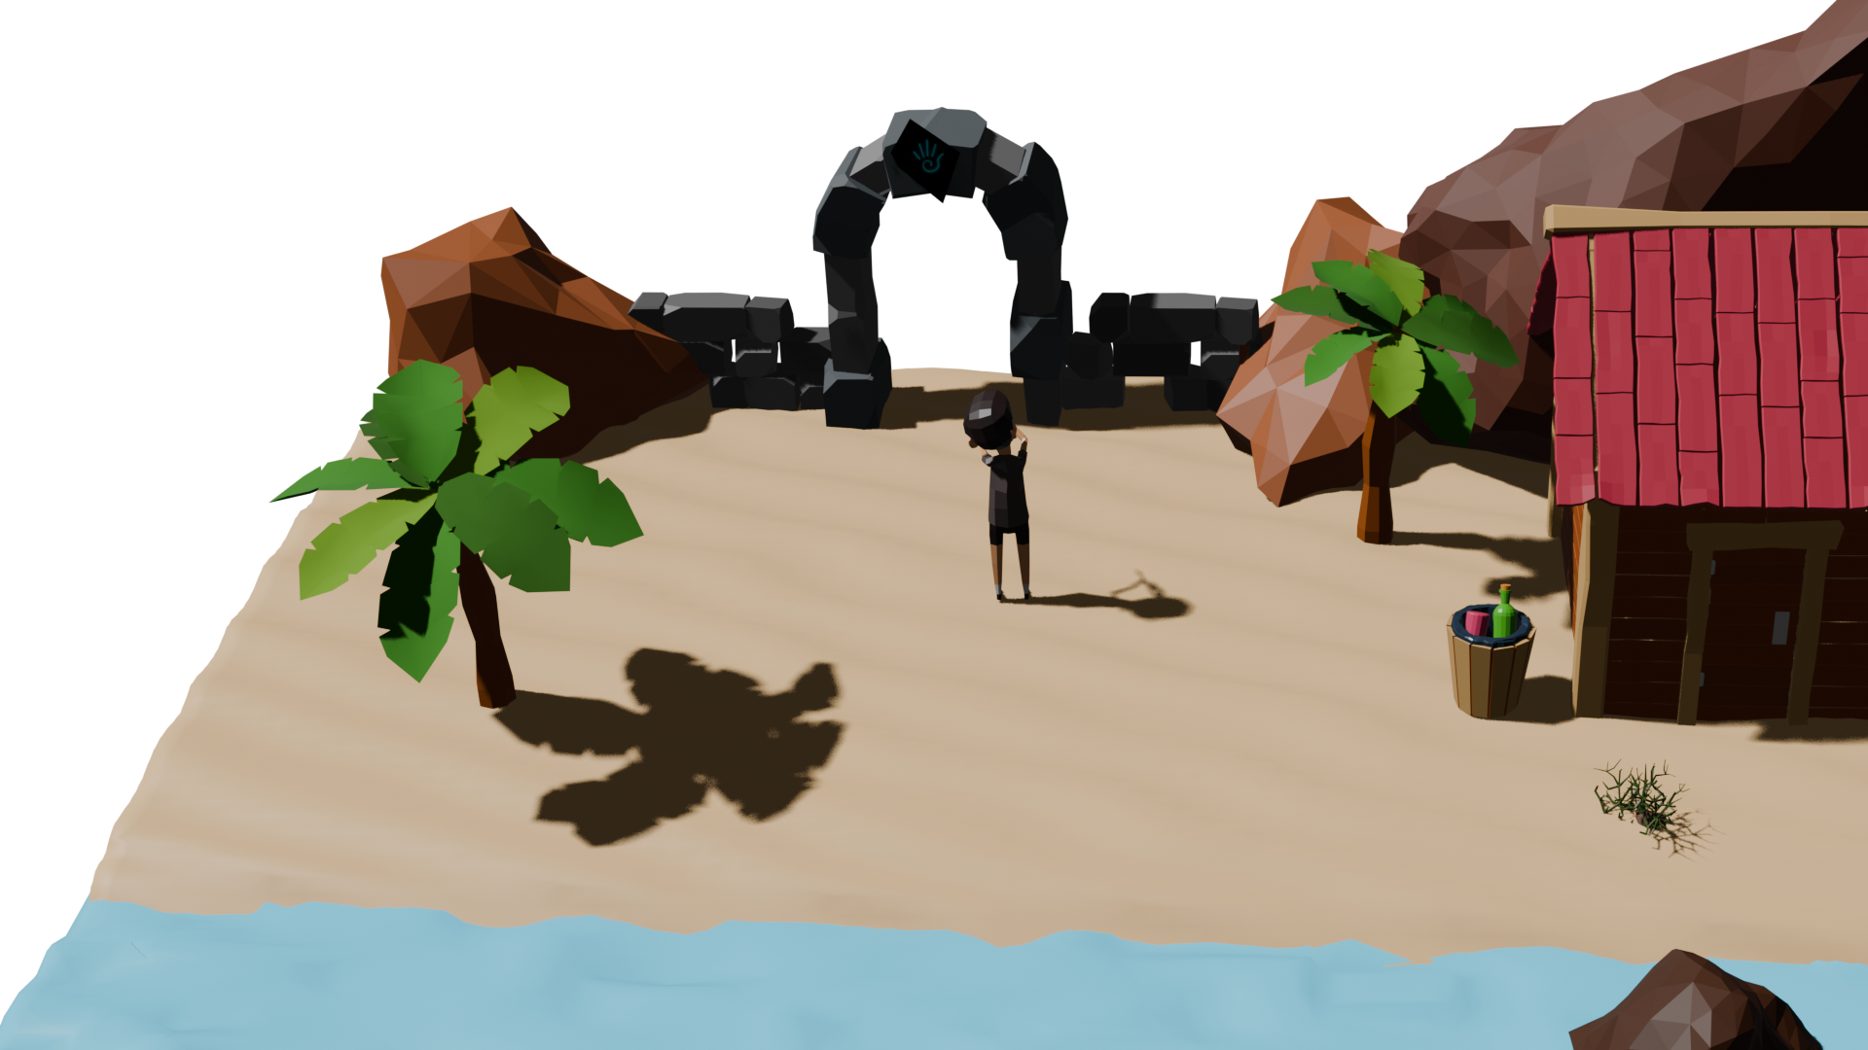
Overview
Project Idea
Timeline and Deliverables
Game Story
Questions
World and Puzzles
Tech Stack
SL
Notes:
? Seconds; Goal: 22 seconds
Overview:
Here's a quick overview of what we'll be sharing with you today. We'll start by
Finally, we'll open the room for questions to the team.
Now we'll hear from Logan about our project requirements.

Slide 4

Project Requirements
Puzzle system with range of challenging or unique puzzles
Progress-tracking system (achievements, unlocking new areas of a map)
Gravity and physics in a 3D space
AI system to compete against the player
Unique look and visual/audio style to the game world
LF

Slide 5
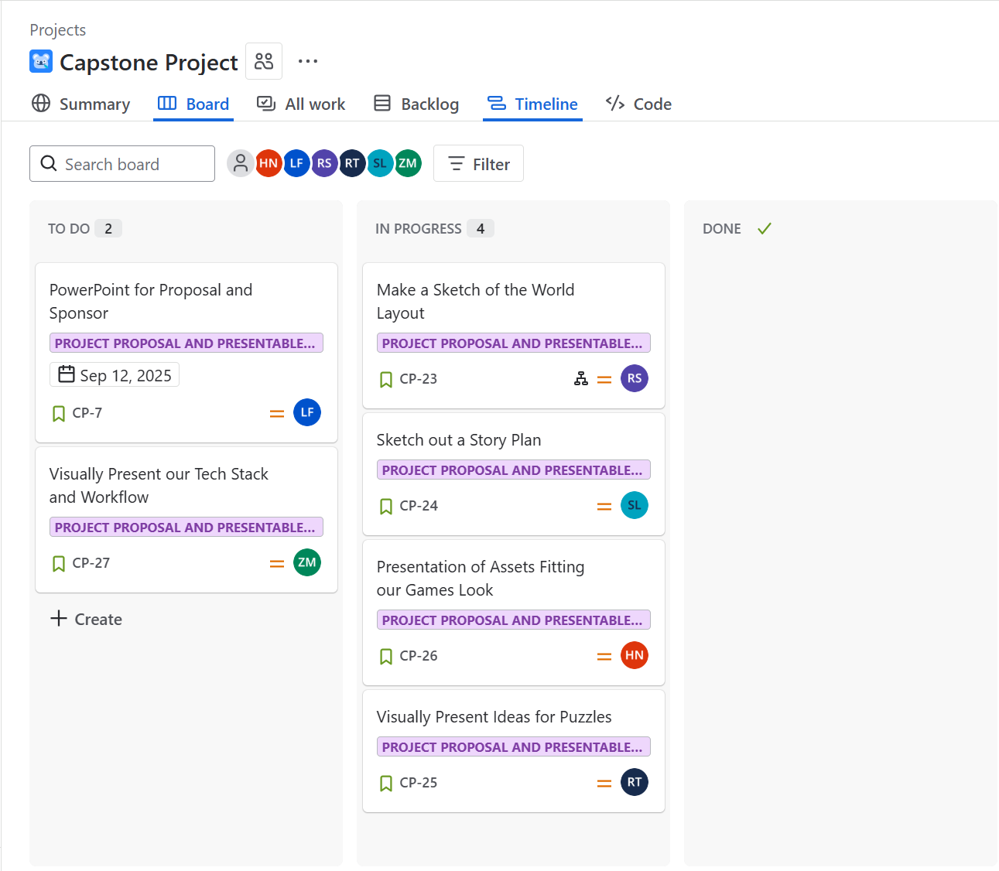
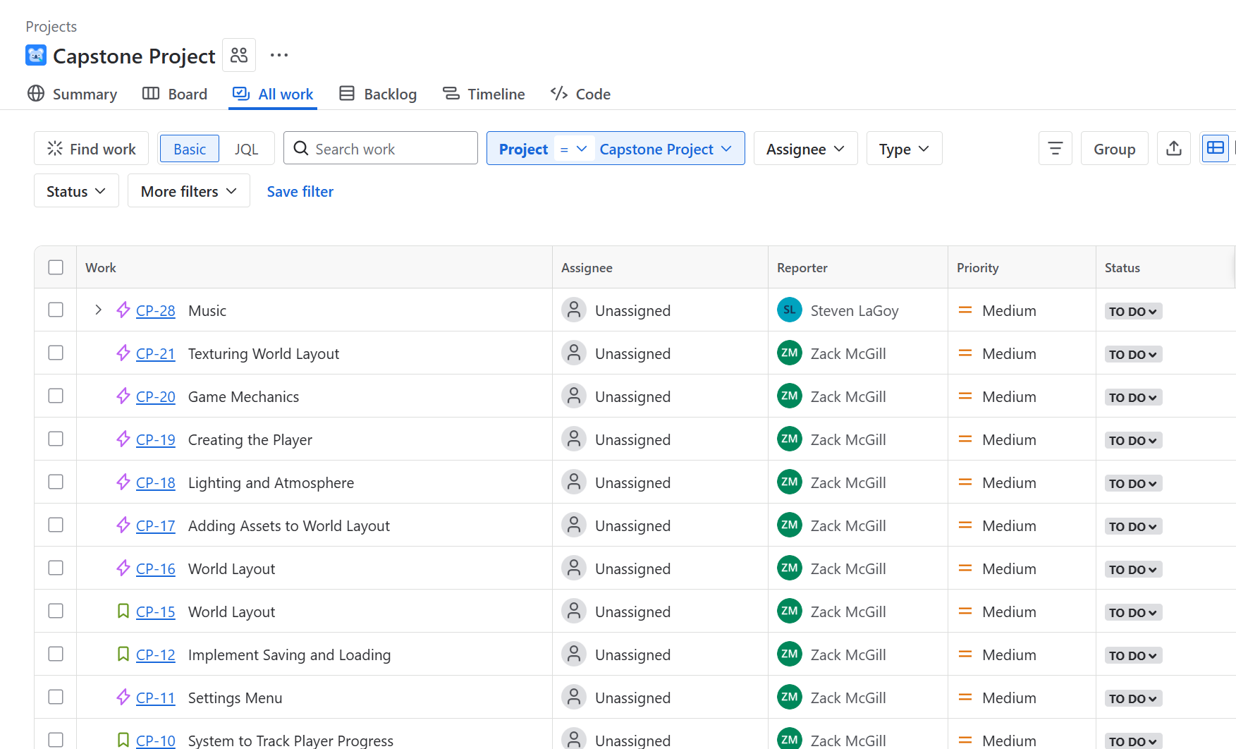
Tech Stack
Tech Stack
Unreal Engine 5
Unreal Engine 5
Visual Studio
Microsoft Teams & Microsoft Outlook
Perforce / Git LFS
Jira
ZM
Notes:
90 Seconds; Goal: 49 seconds
We chose a proven stack to develop our game project. Our first choice was Unreal Engine for its a proven performance given a 3D world. Next, we standardized Visual Studio as our code editor. For collaboration Microsoft Teams and Outlook provide directory search, shared calendars, and one-click meeting scheduling through teams.
Version control was a challenge. Traditional Git and GitHub struggle with large binary assets, so we selected Perforce, a centralized versioning system that is standard in game development. I was able to local host Perforce and build a remote-access setup using tunnels to expose the server without opening inbound firewall ports. I utilized token-based authentication and setup a firewall to reject any connections outside of Indiana. This must have set off a security flag as Campus IT asked us to shutdown the service so they could investigate, and we complied.
Meanwhile, we designed an alternative in which we use Git LFS and GitHub alongside a git ignored folder for large assets. We would share the folder with a peer to peer sharing app. For planning we use Jira for issues, sprints, and roadmaps.

Slide 6
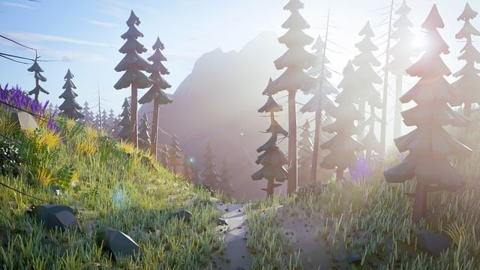
Project Idea
Exploration game
Solve puzzles to continue journey
3D Game Format with a small open world
Music and musical instruments to solve puzzles
LF
Notes:
? Seconds; Goal: 49 seconds

Slide 7
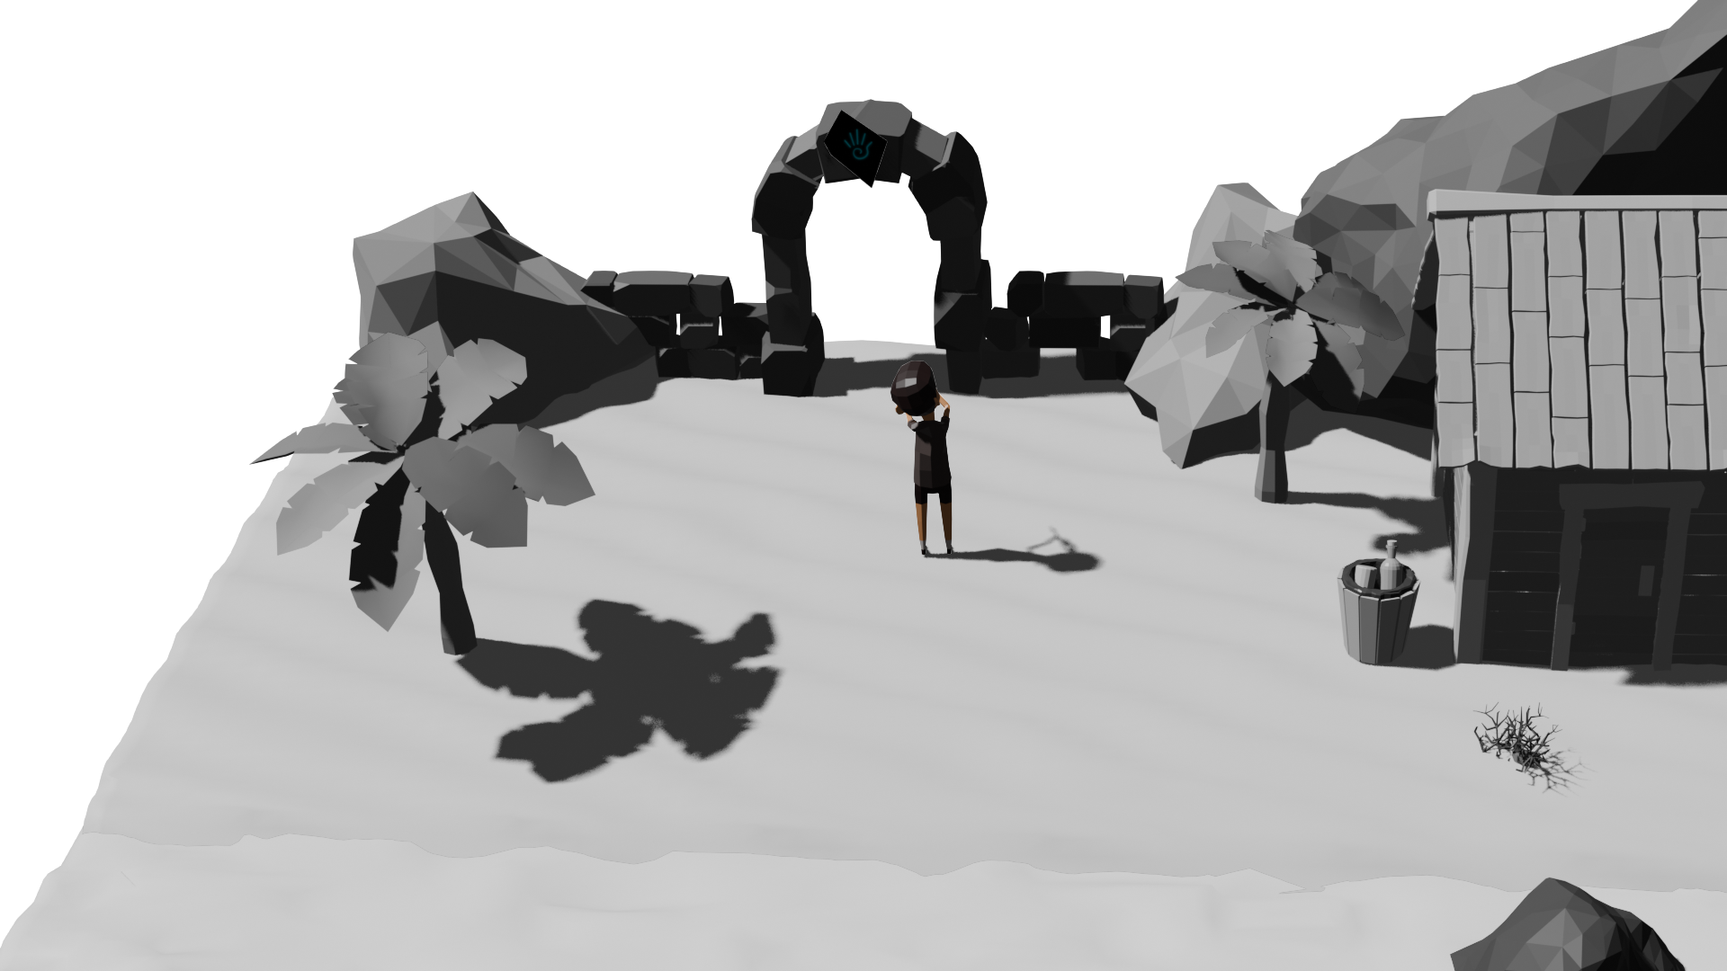
Game Story
Traveling musicians, islands devoid of color, and much more.
RS
Notes:
45 Seconds; Goal: 49 seconds
Great Ideas, and moving on to the game story, we follow our main protagonist, the child of traveling musicians, currently on an ocean expedition. When suddenly, things go awry as the child is mesmerized by the live musical performance and happens to fall overboard. Only to wash ashore the beaches of a dull and colorless island where their passion for music possesses unknown, magical abilities with the potential to restore vibrance and energy to the island. Speaking of which, I'll hand it off to Steven to speak a bit more on the island itself.

Slide 8
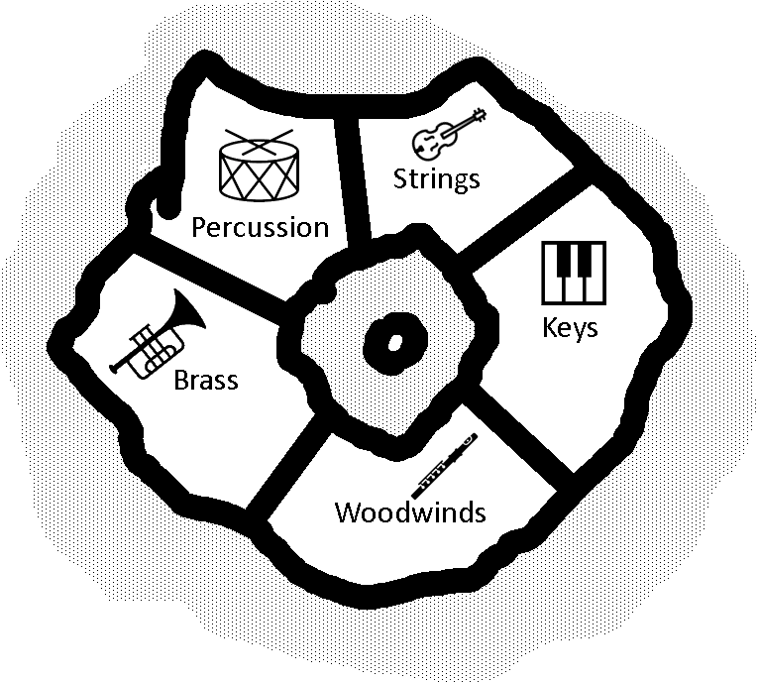
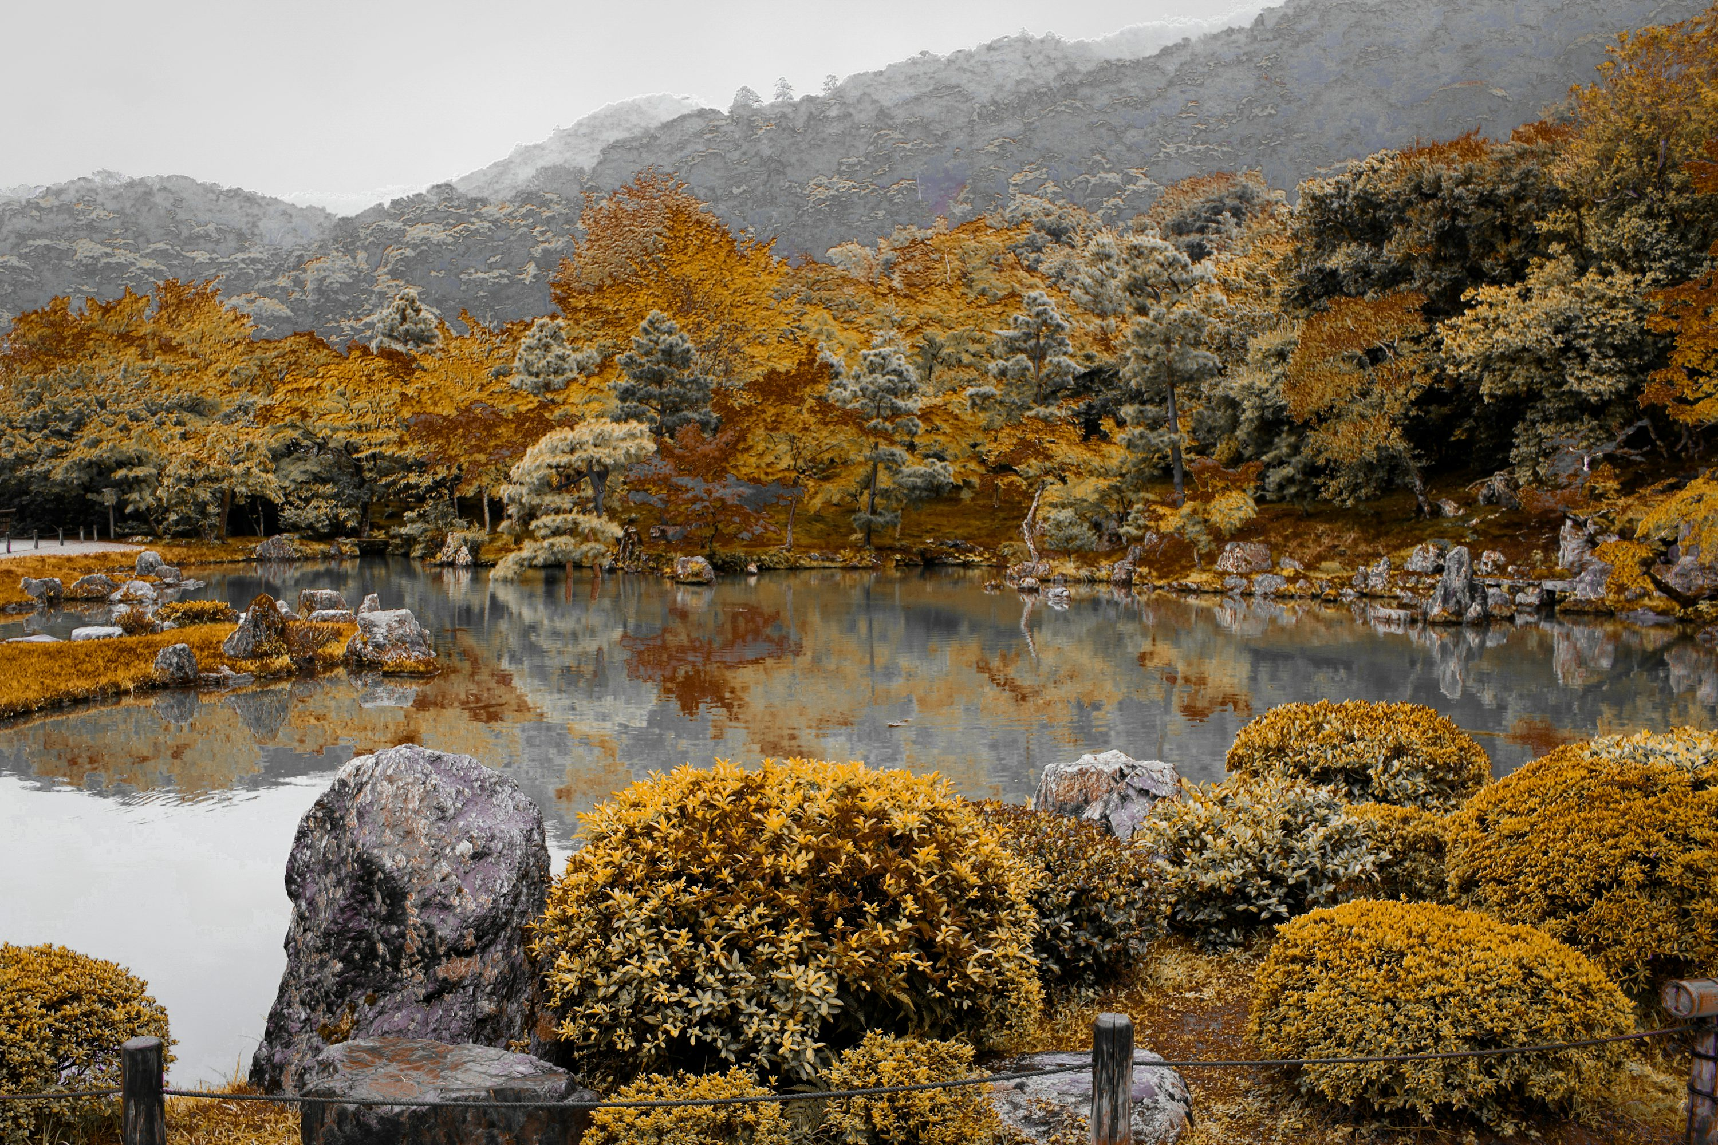
World Design
Areas with different puzzles, themes
Central pond with small island(s)
SL
Notes:
? Seconds; Goal: 49 seconds
This is our early design for the world
We picture several areas with different instruments groups, puzzles and themes
There will be a pond in the center which will slowly come back to life as you solve each area
The central area will have a mix of the music from all areas

Slide 9
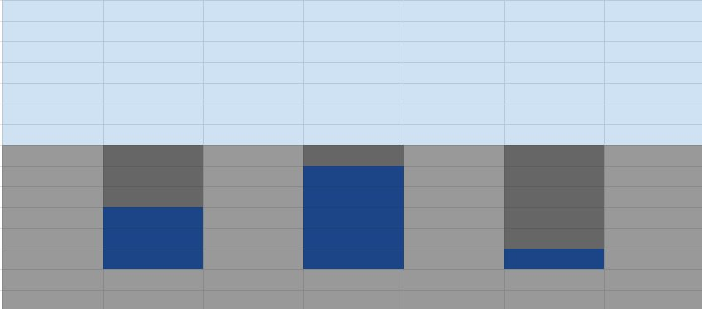
Puzzles
Puzzles combine nature and key parts of each of the instrument families
Winds Puzzle – Fill geysers/tubes/holes with water to match a certain pitch
Percussion Puzzle – Timing-based puzzle with falling rocks or coconuts
RT
Notes:
? Seconds; Goal: 49 seconds
Puzzles play a key role in this game. The puzzles in our game will include both music and natural elements. Each section of the island will have at least one unique type of puzzle related to the instrument type. For example, the winds puzzle can have the player filling tubes with water with the goal of making a certain pitch. This is similar to when you blow over an open bottle and it makes noise. The percussion puzzle can be a timing-based puzzle similar to rock band or dance dance revolution where icons (or coconuts in our case) fall from the top of the screen and the player has to hit a certain key at the right time

Slide 10
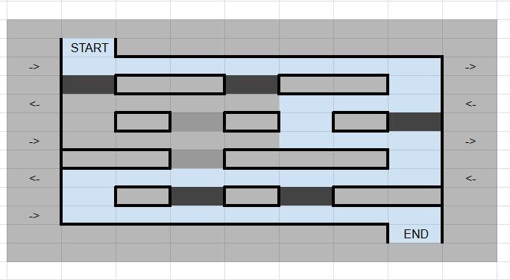
Puzzles
Brass Puzzle – The player will use valves to control the flow of water. They try to reach the end in a certain number of cells
Strings Puzzle – The player will use vines to connect different points
Keys Puzzle – Memory-based puzzle
RT
Notes:
? Seconds; Goal: 49 seconds
Our brass puzzle can focus on the valves and tubing that many brass instruments have. However, rather than air flowing through the tubes, we can recreate that with water flowing down a stream and the player blocking paths to make the water travel a certain distance. The strings puzzle can have different nodes or ends and the player has to connect them with vines which represents stringing an instrument. The keys puzzle can be a memory based puzzle where a certain tune will play, and the player has to repeat it back

Slide 11

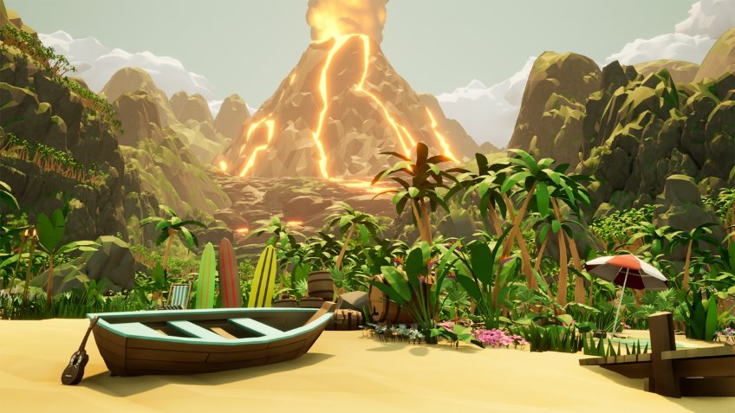
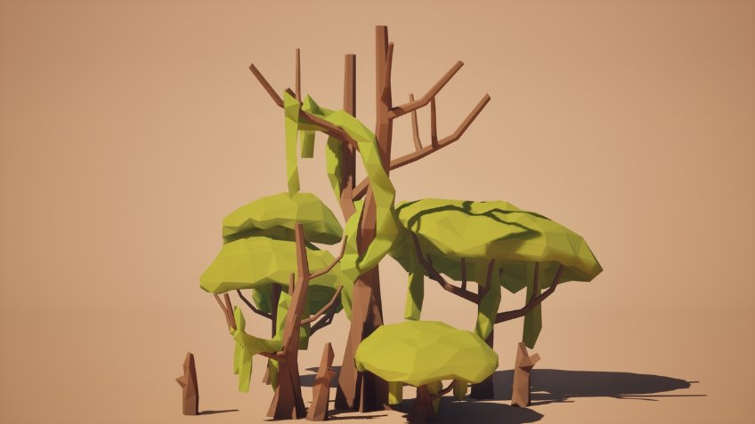
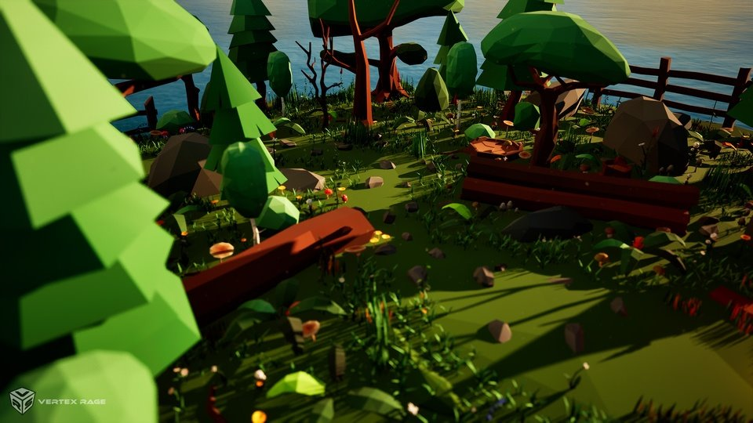
Art Style: Landscape
HN
Notes:
? Seconds; Goal: 22 seconds
For our game, Island Song, we have decided to go with a low poly style for both the landscape and all the characters. The pictures, as shown above, are some assets that we have found that are available on the Unreal Store.

Slide 12
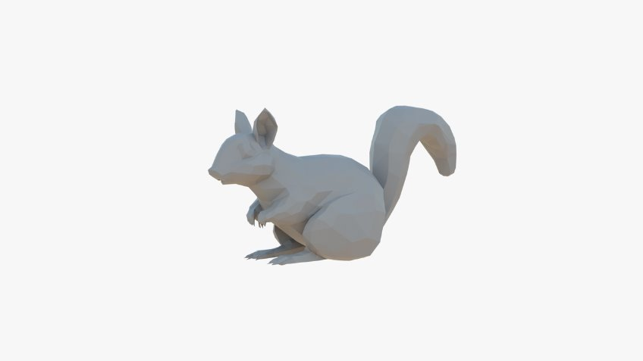
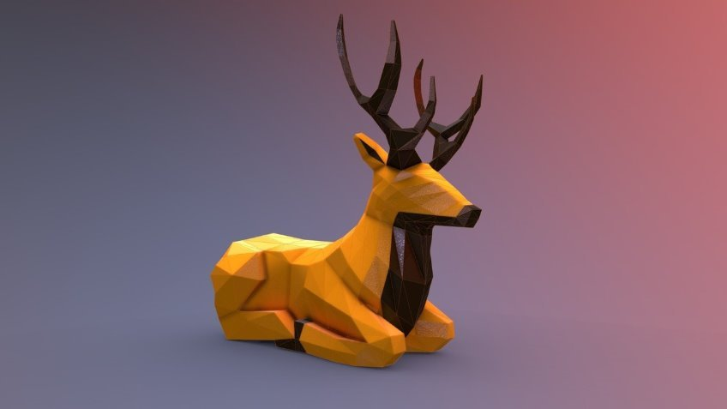
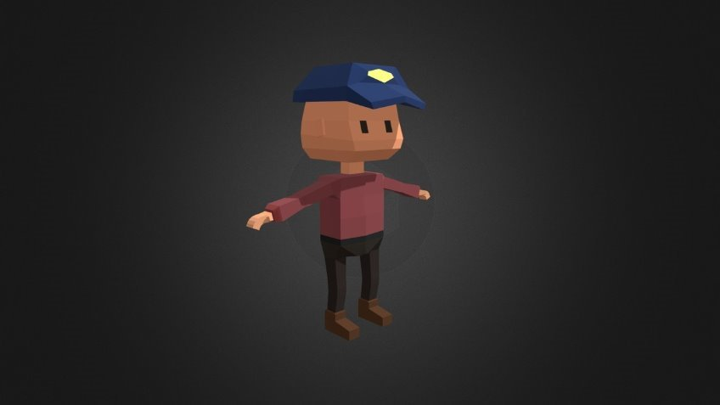
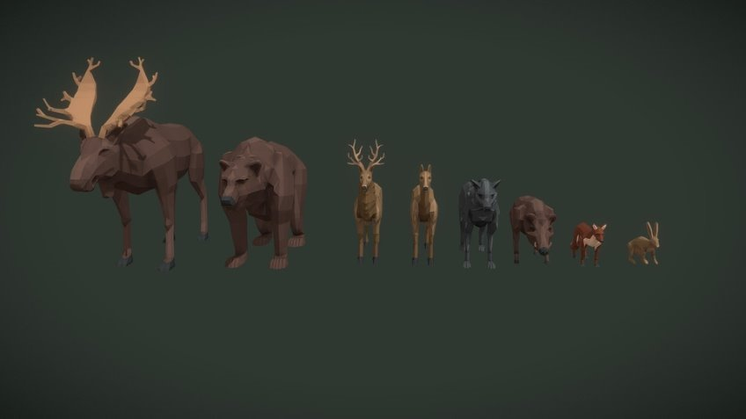
Art Style: Character & Animals
HN
Notes:
? Seconds; Goal: 22 seconds
Pictured here are some assets for some of the characters and animals that will be on the island.

Slide 13
Deliverables
Project Deliverables:
Click-through installer
5 explorable areas
3 unique puzzles
Stretch Goals:
Side quests
Additional puzzles
Various NPCs
Inventory system
Uploading to Steam
RS
Notes:
44 Seconds; Goal 49 seconds
Beautiful assets, thank you Harrison. Now shifting our focus, our team has outlined what we plan to deliver for our final project alongside potential stretch goals. Our deliverables include a click-through installer for Windows that will allow the user to create a desktop shortcut, hosting the installer using Google Drive and GitHub releases, and intuitive menus. For the game itself, there will be a minimum of three uniquely themed areas with corresponding puzzles as well as a progressing story told through an interactive world.
Depending on our progress, we've determined a few stretch goals for our game, consisting of additional side quests, puzzles, NPC interactions, an inventory system, and uploading our game to steam. I'll hand it off to Zach now for a deeper look into our timeline.
Beautiful assets, thank you Harrison. Now shifting our focus, our team has outlined the things we plan to deliver for our finished project. These deliverables include a click through installer for Windows that will allow creating a desktop shortcut. Hosting the installer using Google Drive and GitHub releases. The game itself will be delivered with 5 areas each with a unique corresponding puzzle. A progressing story told through an interactive world. Intuitive menus for the landing screen and settings.
We also outlined a few stretch goals containing side quests with side puzzles, NPC interactions, an inventory system, and uploading our game to steam.

Slide 14
Timeline
Q1 - Fall Midterm
Map terrain nearly finished
Player movement and camera demonstratable
Q2 - Fall Final
1 puzzle MVP's
Map has textures applied
Color mechanic MVP
Q3 - Spring Midterm​
Music, assets, and polish for the area from Q2
Puzzles for remaining 2 areas
Finish character
Q4 – Spring Final​
Finished game​
Create and host installer
ZM
Notes:
60 Seconds; Goal: 49 seconds
We have organized our timeline into four quarters which encompass both semesters. In Q1 we plan to have our map terrain nearly finished and player movement along with the camera demonstratable. In Q2 we plan to have 3 areas each with one unique puzzle along with textures being applied to the terrain from Q1. We also want to add the mechanic to transition between grey scale and color. In Q3 we plan to add music, assets, and polish to the three semi complete areas from Q2 and bring the remaining areas to semi-complete. We also want to implement out chracter at this point. In Q4 we plan to have finished the game. In addition, we plan to have created and hosted an installer for easy access to our game.

Slide 15
Project Risks
Scope creep
Over-emphasis on music
Expensive file sharing
Steep learning curve
HN
Notes:
? Seconds; Goal: 22 seconds
As with every project there are inherently some project risks. As we develop the game, we have to make sure that the scope of the project doesn't become too large. Given the nature of our game, we must prioritize the code aspect of the project and make sure that music isn't over emphasized. Another risk is how we share files since some of the asset files are very large. Finally, since our group doesn't have a lot of experience with Unreal Engine, we will have a steep learning curve to overcome.

Slide 16

Summary
Game Idea + Story: Island Song
World and Puzzles
Tech Stack
Timeline and Deliverables
Questions?
SL
Notes:
? Seconds; Goal: 20 seconds
Just say each main point again. "And now we welcome your questions about the game, our project, and anything we've presented today."
Team members should cover questions for things which are their job (see roles slide). People should not cut in- they should be invited to talk.
Steven will point to audience to elicit questions.
Person answering should restate the question.

